Slide 1


Polymers
Gabriel Oliveira Galvão do Vale 1889469
IEA
Material Science - Dra. Krishnan Bindú
Group 013 M4 1305
May 8th, 2018

Slide 2
Definition

Slide 3
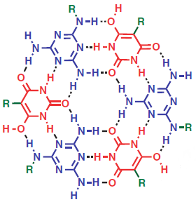
“Many Parts”
pol·y·mer (pŏl′ə-mər)
“Any of numerous natural and synthetic compounds of usually high molecular weight consisting of up to millions of repeated linked units, each a relatively light and simple molecule.”
- The Free Dictionary
Notes:
They’re composed by MANY monomers, and depending on the parts composing it and the way they’re connected polymers inherit different chacacteristics, as we’ll see later on

Slide 4
History

Slide 5
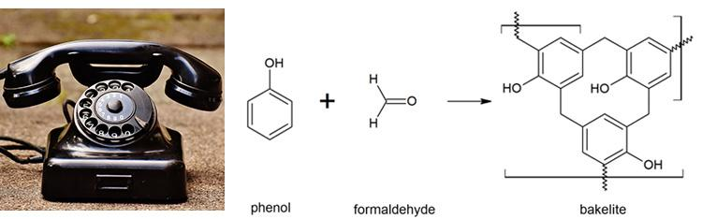
When was it defined?
“lots of small molecules that were interacting strongly with each other”
1920
Notes:
People didn’t have the definition of “macro molecules” just yet: their definition is what we would call colloids today. If you came back in time saying what a polymer actually is, the would say you’re nuts! Even though they used for so long without even realizing, like with wood, cotton and silk. The concept began with a guy named Staudinger in the 1920’s
Picture: Bakelite, nitrocellulose

Slide 6

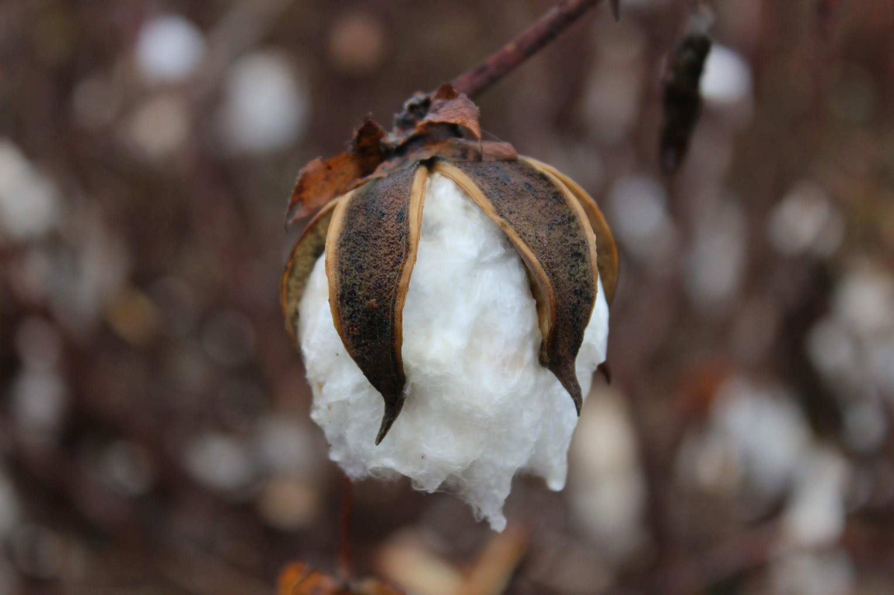
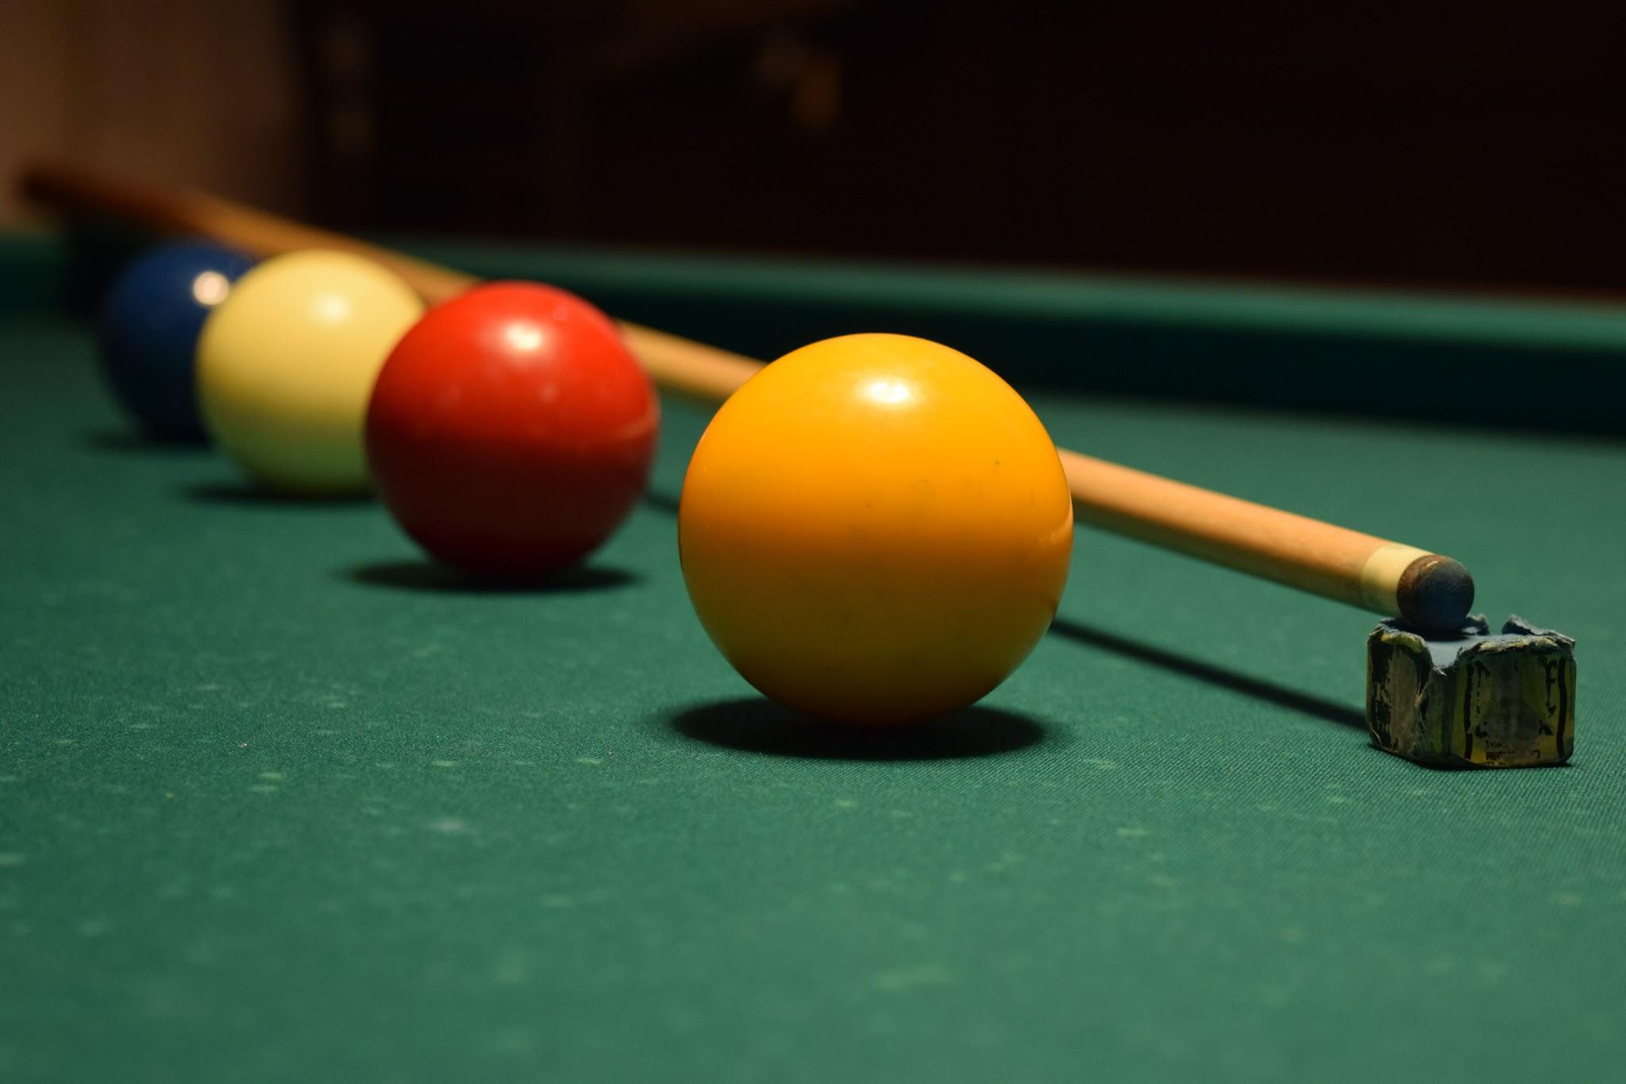
When it actually began?
By the year 1830, when people began playing with cotton (cellulose) - leading to the discovery of Celluloid.
Notes:
People played with cotton back in the time, discovering some nitrides and eventually, celluloid, ehich would make an excelent replacement for billiard balls The problem: the were very flammable and eventually exploded!
Later, Bakelite (the old phone) would be the very first synthetic polymer

Slide 7
Types

Slide 8
Glass Transition Temperature (Tg)
Before we start...
When a polymer gets more fragile with decrease of temperature
Notes:
Have you ever left a plastic bucket or some other plastic object outside during the winter, and found that it cracks or breaks more easily than it would in the summer time? What you experienced was the phenomenon known as the glass transition. This transition is something that only happens to polymers, and is one of the things that make polymers unique. The glass transition is pretty much what it sounds like

Slide 9
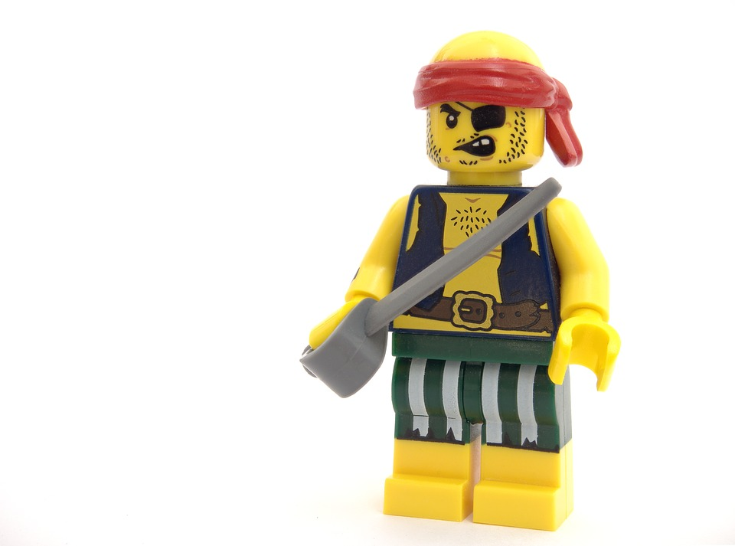

Thermoplastics
A thermoplastic is a type of plastic made from polymer resins that becomes a homogenized liquid when heated and hard when cooled.
Notes:
Thermoplastic polymers can be either amorphous or crystalline. (Linear Bonding)
They behave in a relatively ductile manner but often have low strength.
At a high enough heat the excitation of the molecular chains is enough to overcome this binding force and they are free to move over one another thereby creating a viscous liquid.
When the polymer is cooled the secondary forces once again dominate and the molecular chains revert back to a restricted state. This means that thermoplastics can be melted and remelted allowing them to be easily recycled.

Slide 10

Advantages
Because they soften when heated, thermoplastic polymers are easy to mold into a variety of shapes and also lend themselves to recycling. Common uses for thermoplastic polymers include the fabrication of pipes, ropes, belts, insulators and adhesives.
Notes:
Because they soften when heated, thermoplastic polymers are easy to mold into a variety of shapes and also lend themselves to recycling. Common uses for thermoplastic polymers include the fabrication of pipes, ropes, belts, insulators and adhesives.

Slide 11

Disadvantages
The primary disadvantage of using thermoplastics instead of materials like metal is that thermoplastics can melt.
This makes them disposable and not appropriate for industrial work.
Notes:
The primary disadvantage of using thermoplastics instead of materials like metal is that thermoplastics can melt.
This makes them disposable and not appropriate for industrial work.

Slide 12
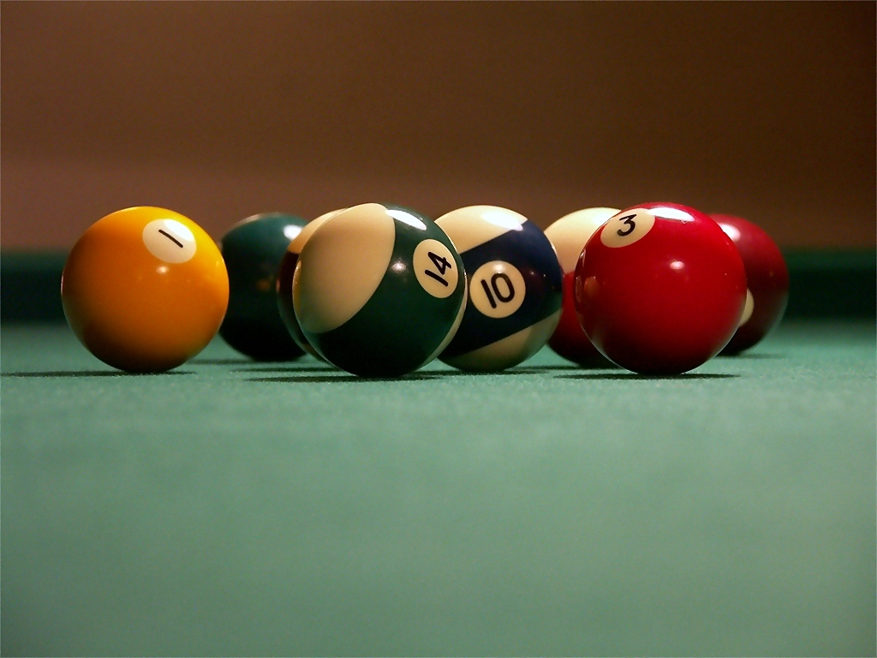

Thermosets
This polymer can only be heated and shaped once.
They only exist in an amorphous state
Notes:
Cross-linking sets the molecular chains in place and therefore means that a thermosetting plastic cannot be remelted but will instead decompose upon being heated to a temperature above the Tg.
Cross-linking inhibits molecular arrangement into an ordered crystalline structure meaning that thermosetting polymers only exist in the amorphous state.
Examples:
Epoxy resins - used as coating materials, caulks, manufacture of insulating materials, etc ...
Phenolic resins - tool handles, billiard balls, sprockets, insulation, etc ...
Unsaturated polyester resins - manufacture of plastics reinforced fiberglass commonly known as polyester, fillers, etc ...

Slide 13
Advantages
Thermoplastics are well suited for many different types of uses, because they have high strength, are lightweight and have relatively low processing costs.
In addition, it's relatively easy to manufacture thermoplastic components quickly in high volumes with high precision.
Notes:
Thermoplastics are well suited for many different types of uses, because they have high strength, are lightweight and have relatively low processing costs.
In addition, it's relatively easy to manufacture thermoplastic components quickly in high volumes with high precision.
Sometimes engineers use thermoplastics instead of metals because of their much lighter weight.

Slide 14
Disadvantages
The thermoset plastics cannot be recycled , They are more difficult to surface finish , They can not be remolded or reshaped .
Notes:
The thermoset plastics cannot be recycled , They are more difficult to surface finish , They can not be remolded or reshaped .

Slide 15
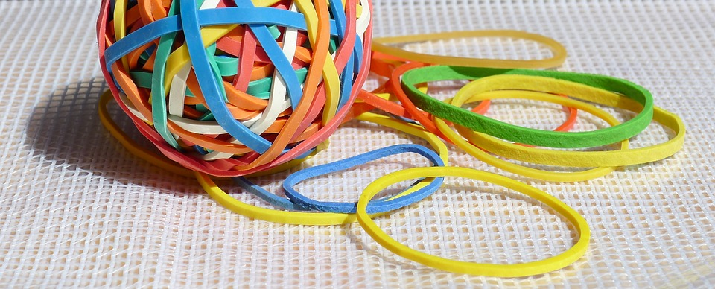
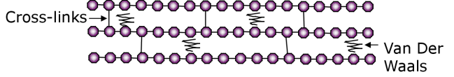
Elastomers
The main characteristic of elastomer materials is the high elongation and flexibility or elasticity of these materials, against its breaking or cracking.
Notes:
At room temperature the level of excitation of the chains has already overcome the secondary Van Der Waals bonds, however, the cross-links that exist in the structure act to revert the elastomer back to its original form following deformation.

Slide 16
Advantages
Recyclable like plastics
Better durability
Resistant to emulsification in damp conditions
Little or no bending
Simpler processing
Have less shrinkage
Better quality control cost
No need to add stabilizers or cure systems
Consumes less energy and more economical control of product quality is possible.
Notes:
Recyclable like plastics
Better durability
Resistant to emulsification in damp conditions
Little or no bending
Simpler processing
Have less shrinkage
Better quality control cost
No need to add stabilizers or cure systems
Consumes less energy and more economical control of product quality is possible.

Slide 17
Disadvantages
Much expensive
General inability to bear load
Can be easily distorted
Poor chemical and heat resistance
High compression set and low thermal stability.
Melting at elevated temperatures
Notes:
Much expensive
General inability to bear load
Can be easily distorted
Poor chemical and heat resistance
High compression set and low thermal stability.
Melting at elevated temperatures

Slide 18
Conclusion
Polymers have great characteristics, a whole gamma of applications everywhere, from our household to the industry and they come in all shapes and sizes.
There’s still many parts uncovered by this presentation, but we hope to give a better understanding of the subject with this document.

Slide 19
References
Elastomer - definition, properties and examples of elastomer. (n.d.). Retrieved from http://www.adhesiveandglue.com/elastomer.html
Girard, L. (2011, May 16). Advantages of Thermoplastics | Hunker. Retrieved from https://www.hunker.com/13408204/advantages-of-thermoplastics
Girard, L. (2011, May 16). Advantages of Thermoplastics | Hunker. Retrieved from https://www.hunker.com/13408204/advantages-of-thermoplastics
The Glass Transition. (n.d.). Retrieved from http://pslc.ws/macrog/tg.htm
Maier, K., & Harris, B. (2018, April 16). What is Thermoplastic? Retrieved from http://www.wisegeek.com/what-is-thermoplastic.htm#
Mayer, M. (2018, April 30). What Is a Thermoplastic Polymer? Retrieved from https://sciencing.com/thermoplastic-polymer-5552849.html
Rehman, R. Z. (2016, February 26). Elastomers. Retrieved from https://www.slideshare.net/ZiaRehman18/elastomers-58777105
School of Materials Science and Engineering. (n.d.). Retrieved from http://www.materials.unsw.edu.au/tutorials/online-tutorials/8-polymer-types
Thermoset - definition, properties and examples of thermoset. (n.d.). Retrieved from http://www.adhesiveandglue.com/thermoset.html
What is a polymer? (n.d.). Retrieved from http://www.pslc.ws/macrog/kidsmac/basics.htm
Polymer. (n.d.). Retrieved from http://www.thefreedictionary.com/polymer

Slide 20


